Slide 1
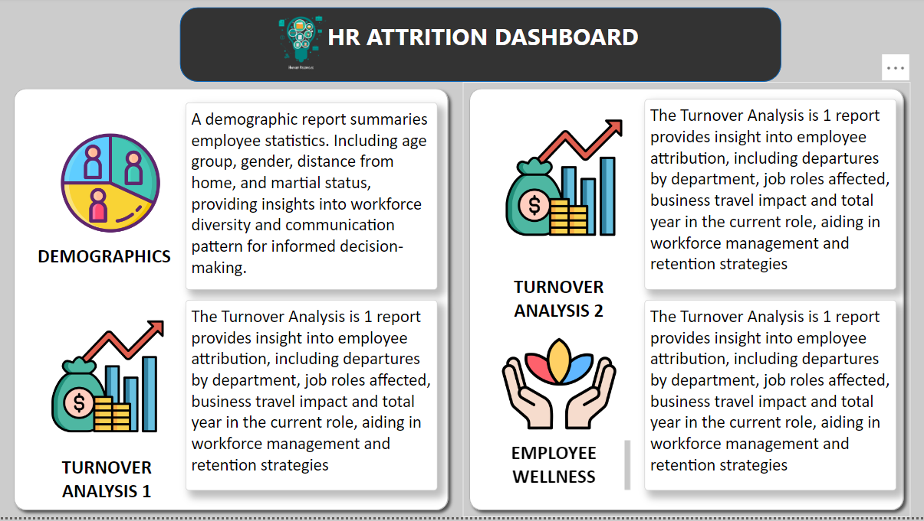

Slide 2
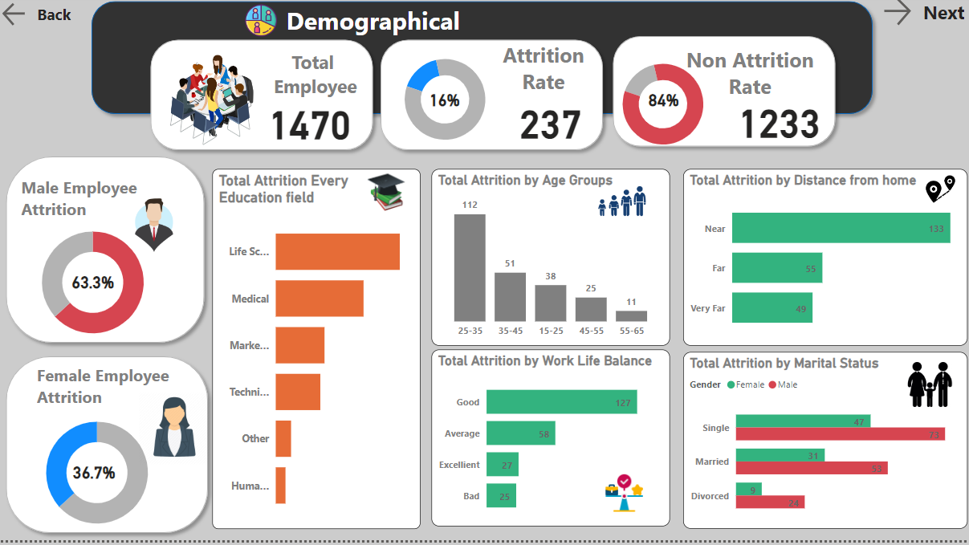

Slide 3
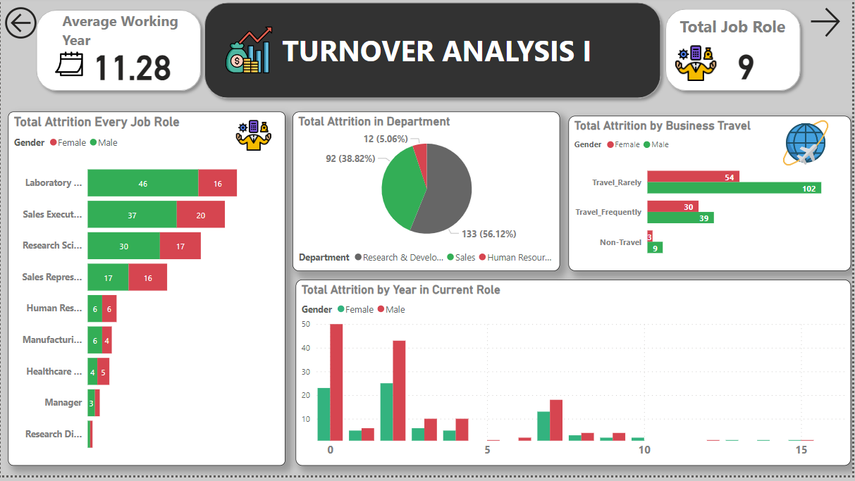

Slide 4
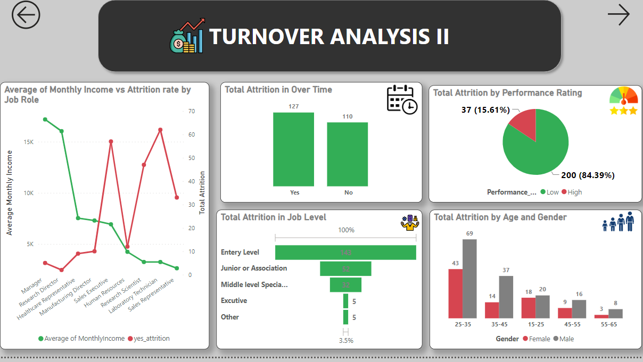

Slide 5
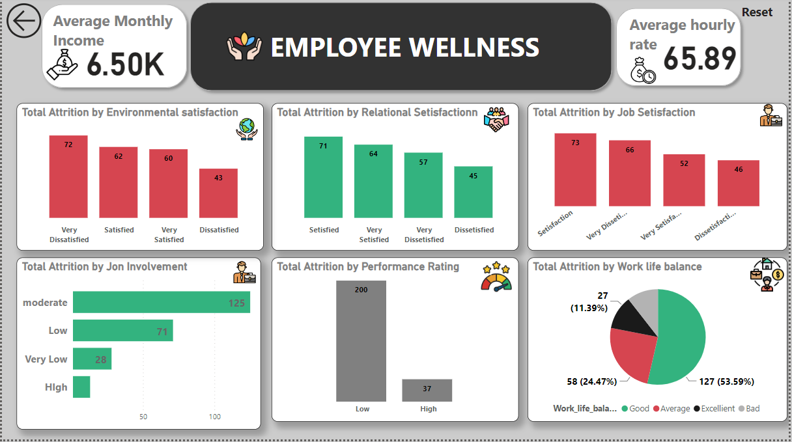

Slide 6
Conclusion
Demographical
The total Attrition rate is almost 16% (237) and Non Attrition rate is almost 84% (1233).
male and female Attrition rate is 63.3% and 36.75 out of 237.
Highest Attrition rate in Life Science Education filed than follow medical and marketing field.
And some major attrition in –
Age group – 25-35 than follow 35-45
Work life balance – more attrition rate who work life balance is Good.
Distance from home – mostly high Attrition rate of Near category in distance.
And marital status is Single.
Turnover Analysis I and II
High Attrition Rate in Job Role is Laboratory Technical and Sales Executive in Male category.
High attrition rate in Research and Development Department and who Travel Rarely for job.
And high attrition rate in 0 to 5 yea Current role.
We found that some Inverse relationship between monthly income and attrition rate, we show that- When monthly income was high than Attrition rate is Low , but when monthly income is low
than attrition rate is high.
High Attrition rating in Entry Level job level and Performance rate is low.
Employee Wellness
And we also Analyzed Employee wellness and found that –
Environmental Satisfaction is Very Dissatifaction, Relational Satisfaction is satisfied.
Job Setisfaction is Satisfied, Job Involvements is moderate and work life balance is Good.

